Slide 1
Outline
Introduction: Overview of Detection-as-Code (DaC) and its advantages.
Limitations of Common Security Tools: Why traditional approaches fall short.
Key Components:
Detection-as-Code Process: Step-by-step implementation of DaC.
Test-Driven Workflows: Ensuring detection efficiency with test cases.
Accountability and Version Control: Maintaining integrity and tracking changes.
Full Architecture Flow: A visual diagram connecting all elements.

Slide 2

Limitations of Common Security Tools
Challenges in Traditional Threat Detection
✅ High Maintenance – Frequent tuning and manual updates.
⚠️ Difficult to Track – No centralized change management.
📏 Not Scalable – Struggles with enterprise growth & threat evolution.
📉 No Version Control – Hard to audit & roll back changes.
⛔ Prone to Human Error – Manual workflows increase risk.
Notes:
Traditional security tools have significant limitations. Most require **manual configuration**, making them cumbersome to manage and prone to inconsistencies across environments.\n\nAnother major issue is the **lack of automation**. Without automated workflows, security teams must manually update and deploy detection rules, increasing the risk of errors and delays.\n\nFinally, **poor version control** means changes to security rules are difficult to track, validate, and roll back if necessary. These issues highlight the need for a more modern, code-based approach to threat detection.

Slide 3
Detection-as-Code
Building Threat Detections Like Software
CI/CD, but for Security
✅ Code-Based Rules – Treat detections as code, stored in a version-controlled repository.
✅ Automated Testing – Validate detection logic before deployment.
✅ Continuous Integration – Detect rule changes, test automatically, and push updates.
✅ Continuous Deployment – Seamlessly roll out validated detections to production.
✅ Monitoring & Feedback – Iterate based on false positives, attack trends, and SOC feedback.
🚀 Faster Detection Deployment – Automated pipelines reduce manual effort.
🔍 Better Accuracy & Testing – Reduces false positives and ensures high-quality detections.
📂 Version Control & Rollback – Tracks all changes and allows easy rollback if needed.
📈 Scalability & Collaboration – Supports enterprise growth and enables team collaboration.
🛡 More Resilient Security – Enables adaptive, real-time threat detection.
Notes:
Detection-as-Code (DaC) applies software engineering principles to cybersecurity. Instead of manually configuring security tools, we automate detection processes through code—just like Infrastructure-as-Code (IaC) does for IT environments.\n\nThis approach enhances efficiency by enabling automated workflows, reducing human errors, and ensuring consistency across security rules. With GitOps, version control, and automated testing, security teams can collaborate more effectively while maintaining high reliability.\n\nBy treating detections as code, organizations gain better security posture, streamlined updates, and the ability to adapt quickly to emerging threats.

Slide 4




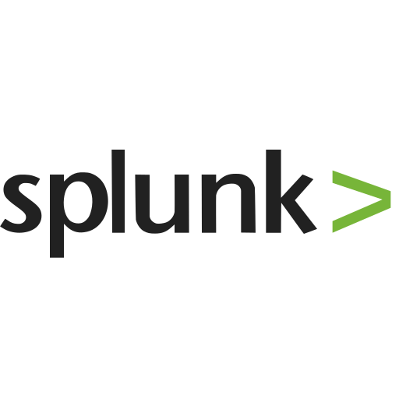



🏗 Key Components
Building Blocks for an Automated Security Workflow
Vector
Standardize Format
Central Git Repository
Query Converters
SIEM
Infrastructure as Code
GitOps Workflows
Branch & Version Controls
Notes:
Detection-as-Code relies on key components to function efficiently. At its core, a **GitHub repository** serves as the central storage for all detection rules. These rules are written in Sigma, a generic format for threat detection queries.\n\nTo deploy these rules across different security platforms, **Sigma rule converters** transform them into specific query languages like SPL (for Splunk), VRL (for Vector), and HCL (for HashiCorp tools).\n\n**GitOps workflows** automate this process by handling rule conversion, validation, and deployment using CI/CD pipelines. Finally, **branch controls** ensure changes undergo proper review through pull requests (PRs), commit checks, and approval processes, maintaining security integrity.

Slide 5
Detection-as-Code: Step-by-Step
Write Sigma Rules
1
Define detection and transformation logic.
2
Upload to GitHub
Store rules in a central repository.
GitOps Conversion
3
Translate rules to different query languages.
4
Test and Validate
Verify queries with test cases.
Maintain with PRs
5
Secure with branch protections, commit checks, PR approvals.
6
Deploy on Merge
Automated deployment to production.

Slide 6
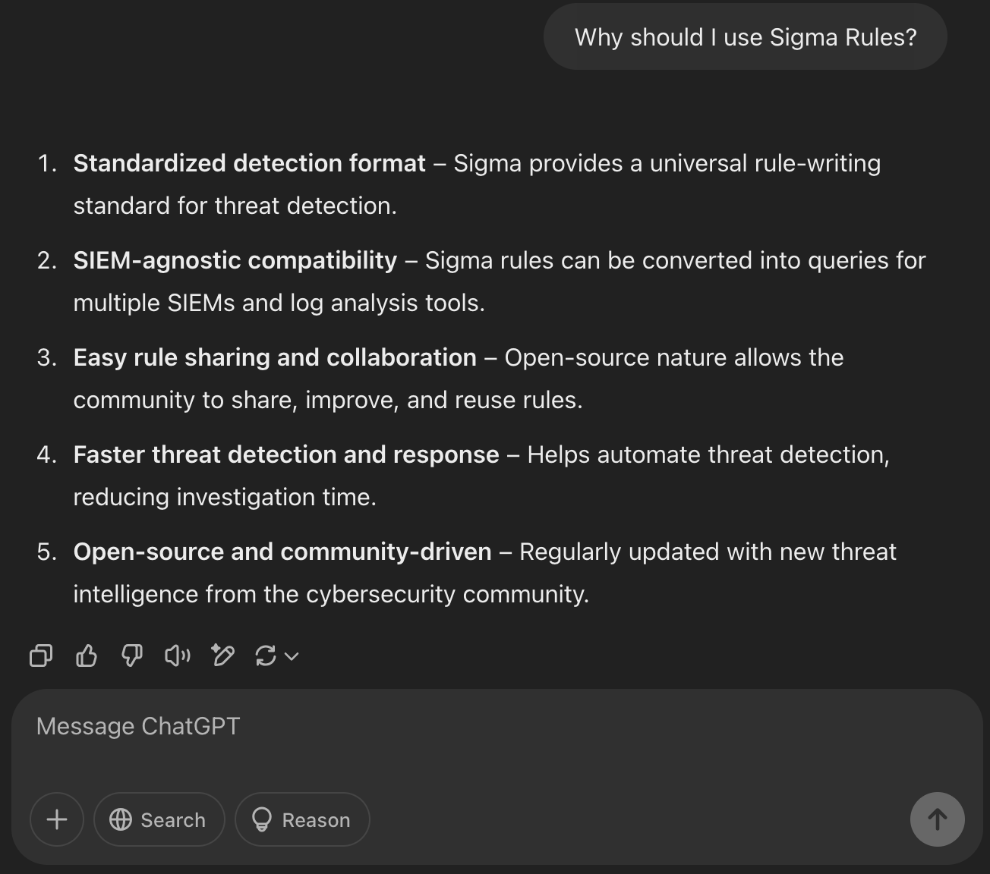
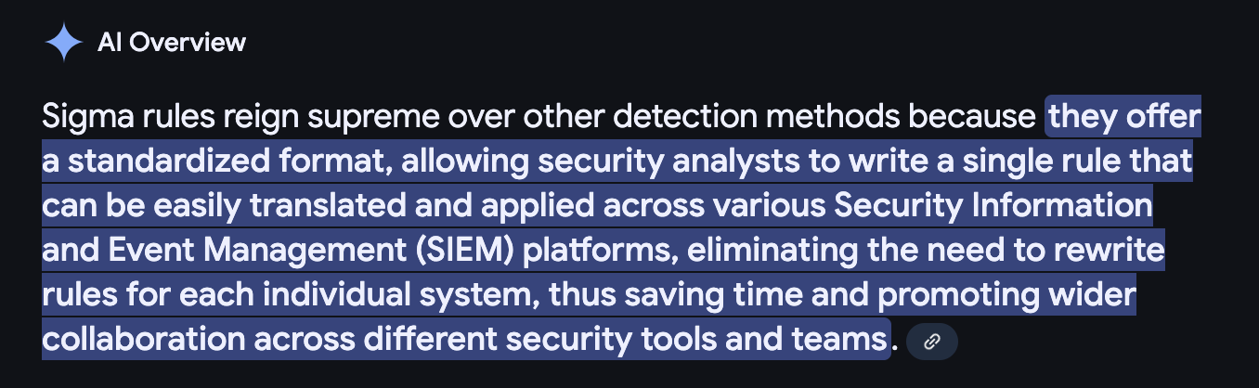
Why Sigma?

Slide 7
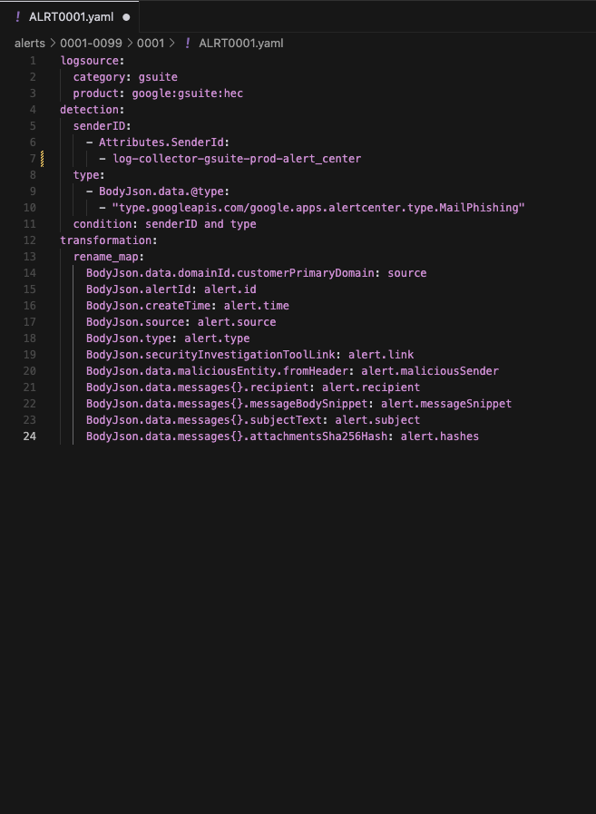
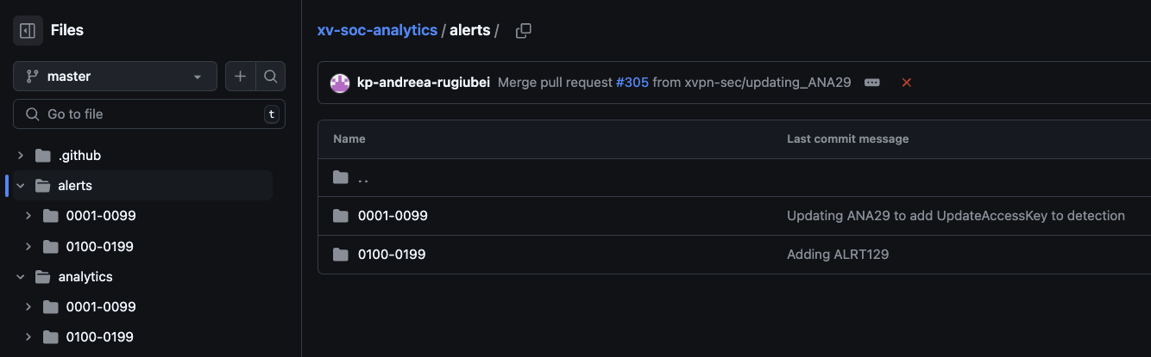
Write Sigma Rules
1
Log Source
Original logs which the rules will be applied.
2
Detection
Rule logic to detect.
3
Transformation
Transform the original event fields to more human friendly names.

Slide 8
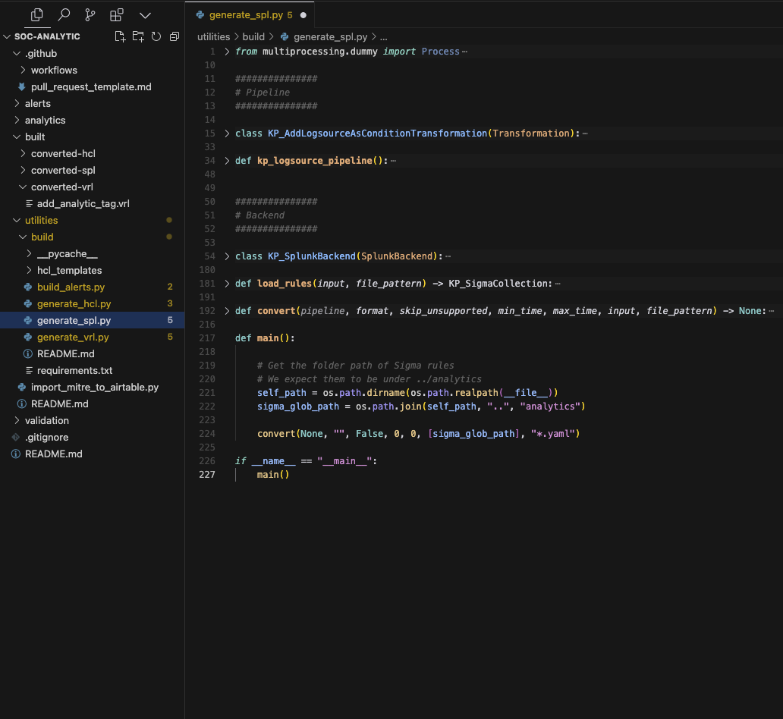
Rule Conversion: Supporting Multiple Formats
1
SPL Converter
2
VRL Converter
Converts Sigma rules to Splunk queries.
Translates Sigma rules to Vector VRL.
3
HCL Converter
Supports HashiCorp Configuration Language.
Note: These will be running as Github workflows whenever a new PR is created.

Slide 9
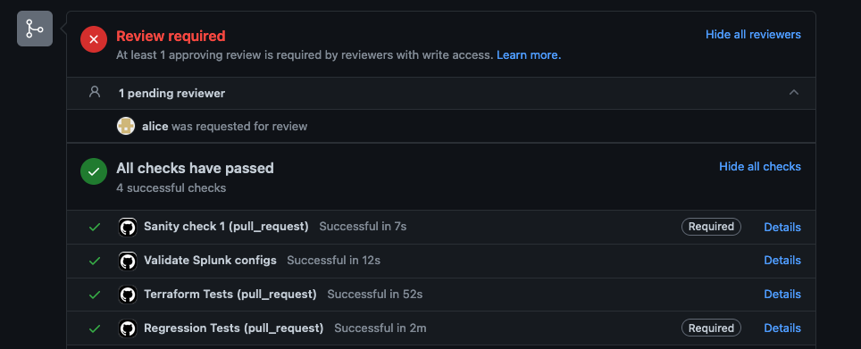
Test-Driven Workflows
Ensuring Detection Accuracy
Containerized Testing: Use isolated environments (Vector) to test detection rules.
Apply Configuration: Apply converted rules into the isolated temporary environment.
Event Matching: Verify if detection rules match expected test cases.
Automated Validation: Github workflows validate the results through commit checks.
Notes:
Test-driven workflows are a critical component of Detection-as-Code, ensuring that detection rules function correctly before deployment.\n\nThe process starts with **containerized testing**, where isolated environments, such as Vector, are used to execute detection rules safely. Once inside the test container, the system **applies the configuration**, ensuring all transformations and queries work as intended.\n\nNext, the detection logic undergoes **event matching**, checking whether incoming security events align with predefined test cases. Finally, an **automated validation process** is executed via CI/CD pipelines, guaranteeing correctness before rules are deployed to production.

Slide 10




Branch Controls: Ensuring Quality
Pull Requests (PR)
Code review and collaboration.
Commit Checks
Automated code validation.
Git Revert & Version Control
Convenient rollback to previous versions.
Approval
Adaptability to Segregation of Duties (SOD).

Slide 11
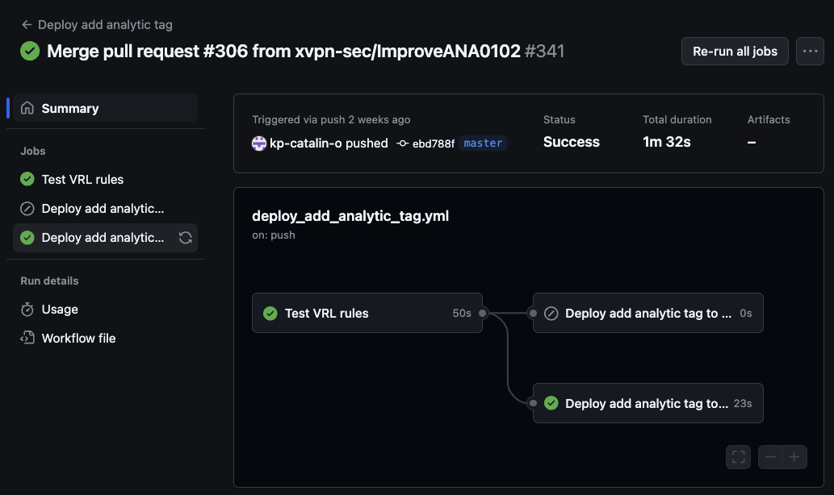
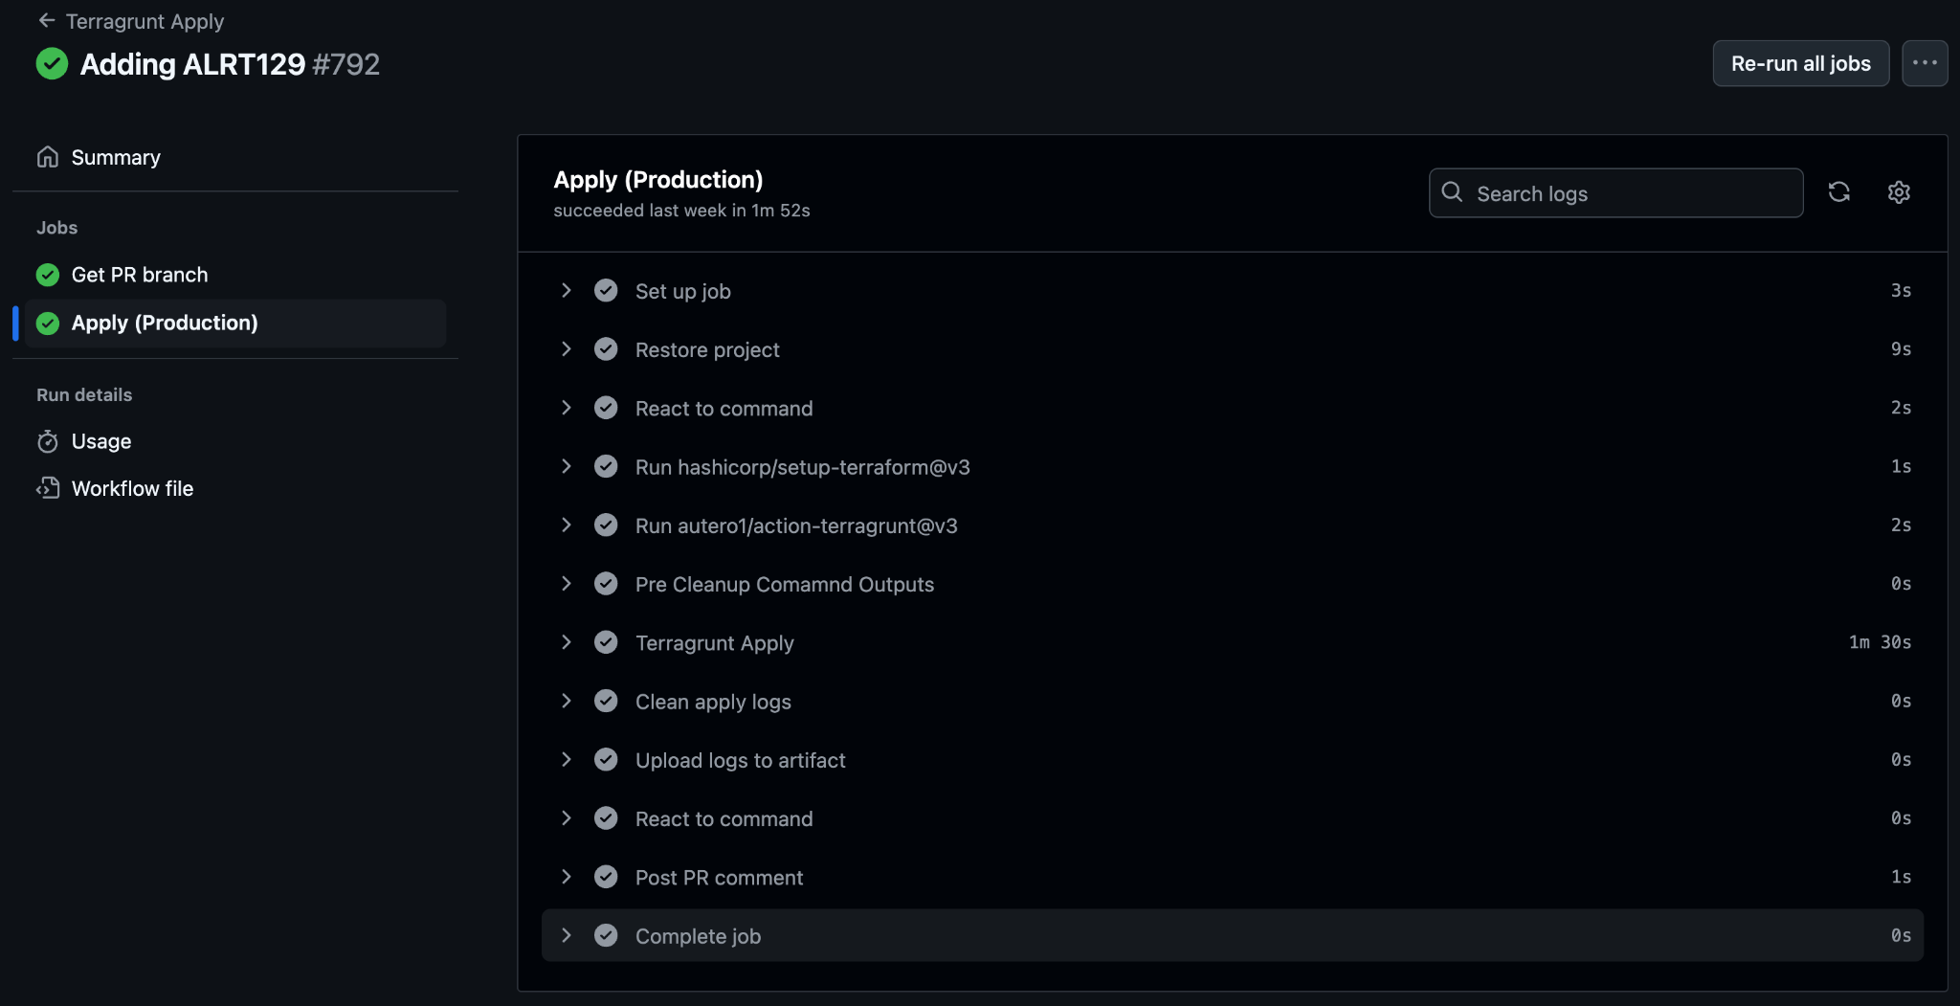
After all the checks have been passed ✅ ✅ ✅
Deploy to Vector
Deploy to Splunk
using
Terraform

Slide 12
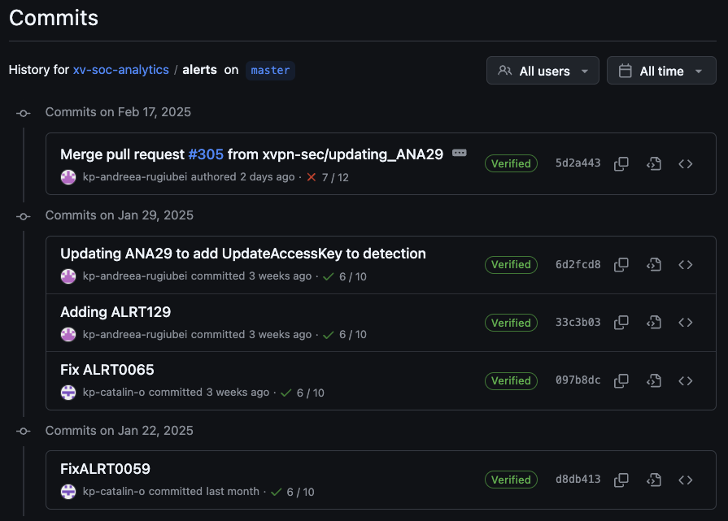
Accountability and Version Control
Detailed Audit Trails Track changes and identify responsible parties.
Version History Rollback to previous states if needed.

Slide 13
Full Architecture Flow
Detection-as-Code End-to-End Pipeline

Slide 14


Conclusion
Key Takeaways from Detection-as-Code
Automation & Efficiency
Streamlined threat detection through CI/CD and GitOps.
Test-Driven Approach
Ensures detection accuracy before deployment.
Accountability & Versioning
Track changes and enforce peer reviews.

Slide 15
Q&A
Anything but my number 🥸
Notes:
Now it's time for questions! This is your opportunity to clarify any points, discuss **implementation challenges**, and explore **best practices** for adopting Detection-as-Code in your environment.\n\nWhether you're curious about **GitOps workflows, test-driven detection**, or **version control strategies**, feel free to ask.\n\nLet's dive into a discussion to ensure you leave with a solid understanding of how to implement Detection-as-Code effectively.

